Slide 1

Developing a Hazard Identification Tool for Chemical Ingredients
Suong Tran
Notes:
p-Mentha-1,8-dien-7-ol

Slide 2
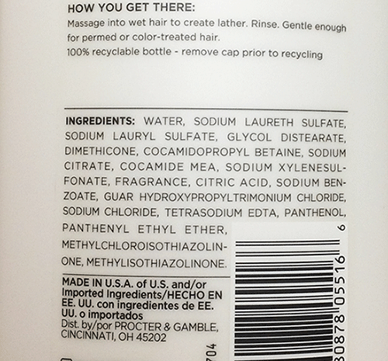
Implication for stakeholders
Consumers:
Accessibility
Product Manufacturers:
Transparency
????????
Ethical, legal, societal implications
Informed Consent
Public Health
Liability
Copy right of formula

Slide 3
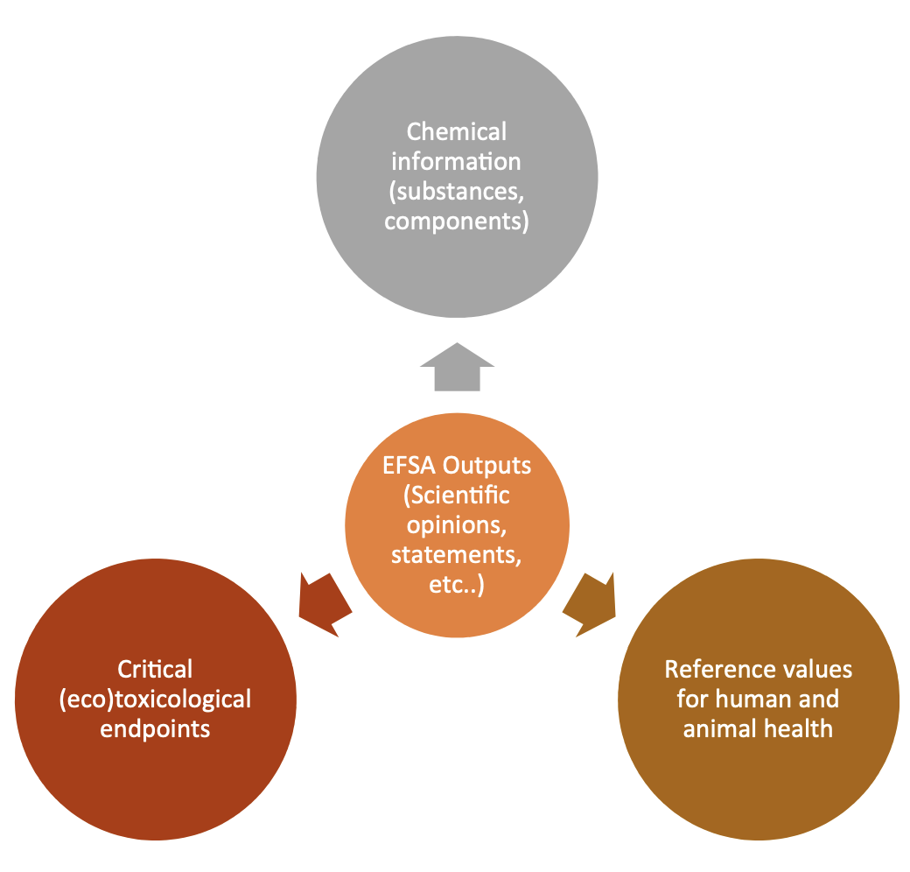
OpenFoodTox

Slide 4
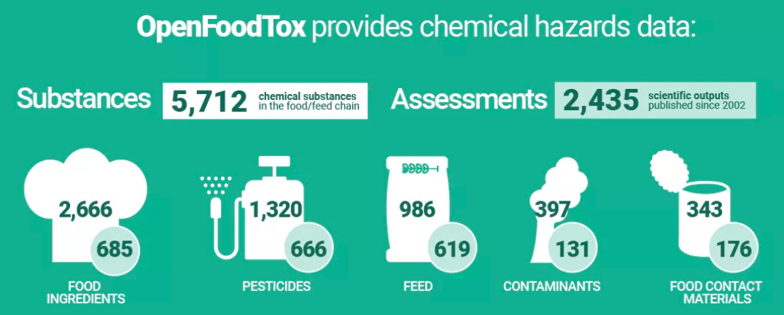

Slide 5
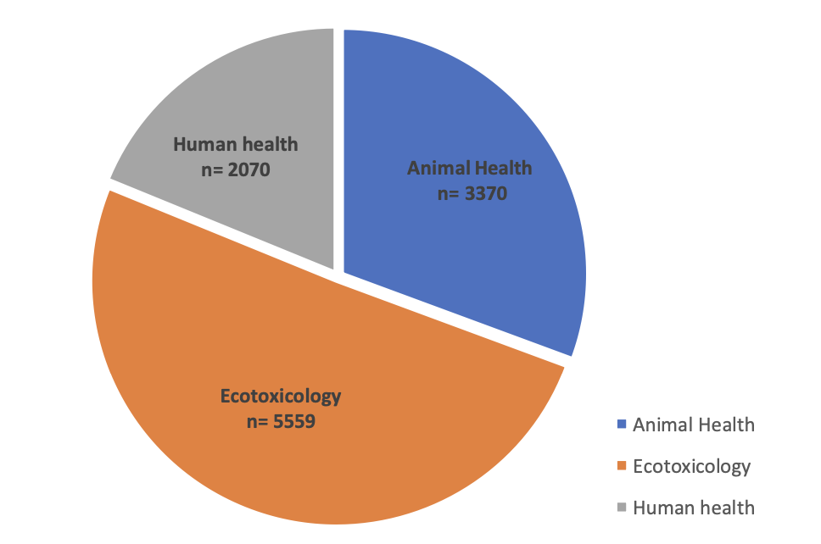
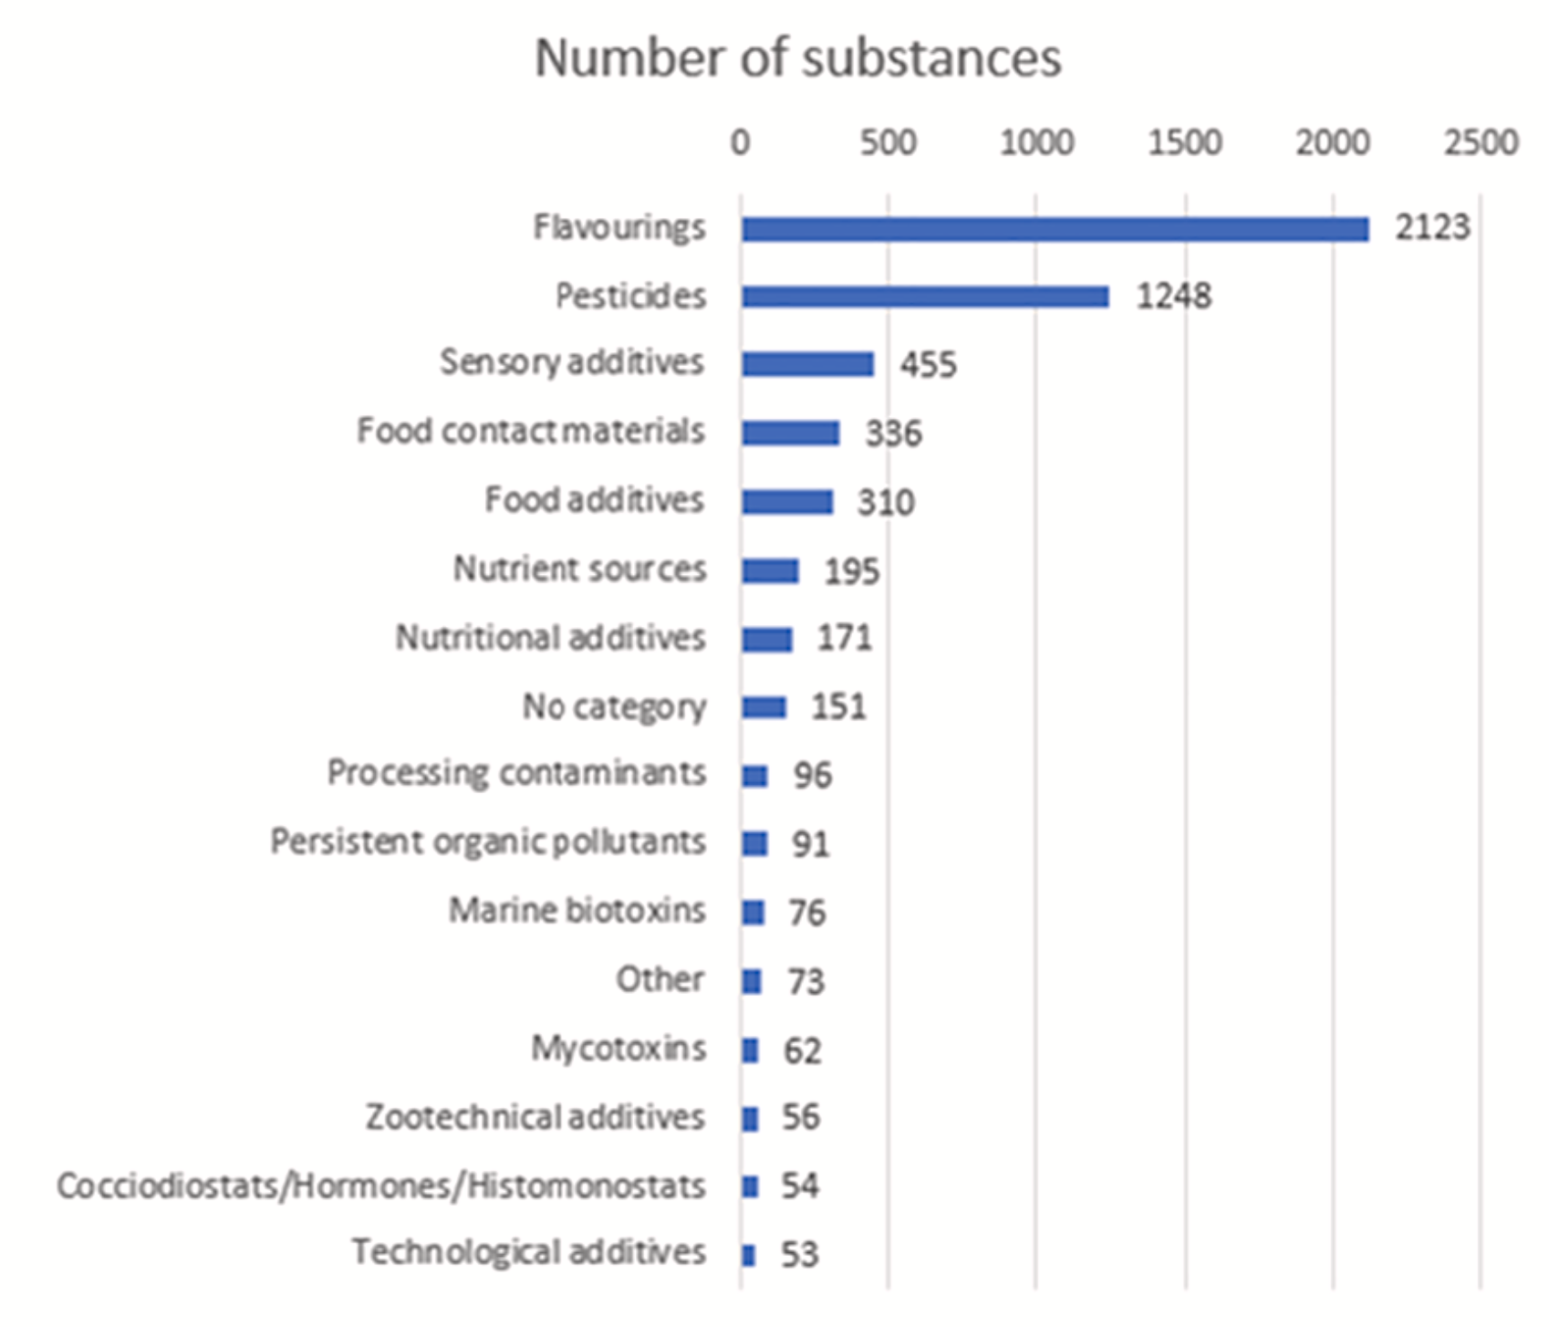
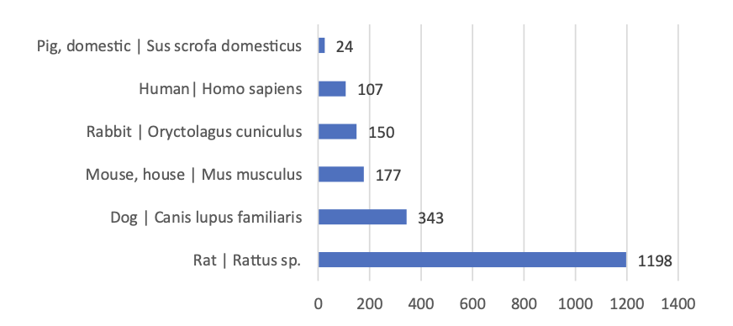
toxicity studies collected in OpenFoodTox
Human health area: Data entries in the database are shown for sub-chronic and chronic studies for reported species

Slide 6
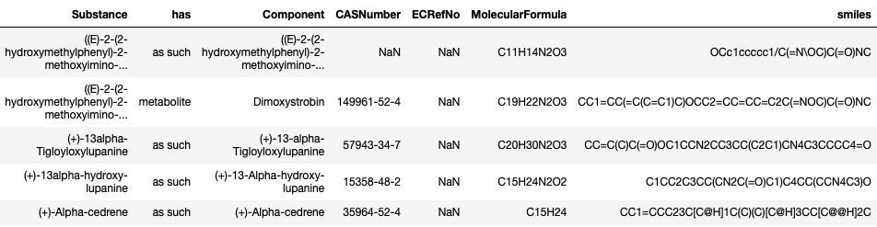
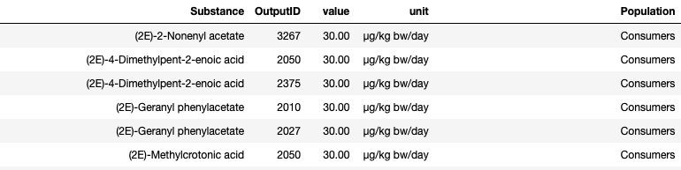
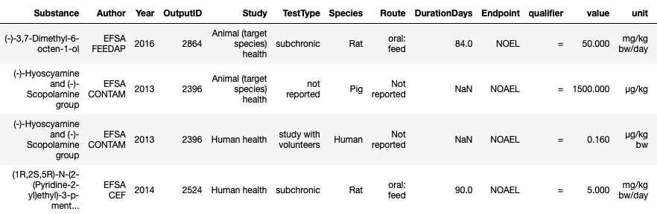
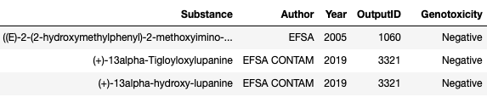
Substance characterization
4019 rows
Reference Value
10141 rows
Reference Point
2569 rows
Genotoxicity
10511 rows

Slide 7
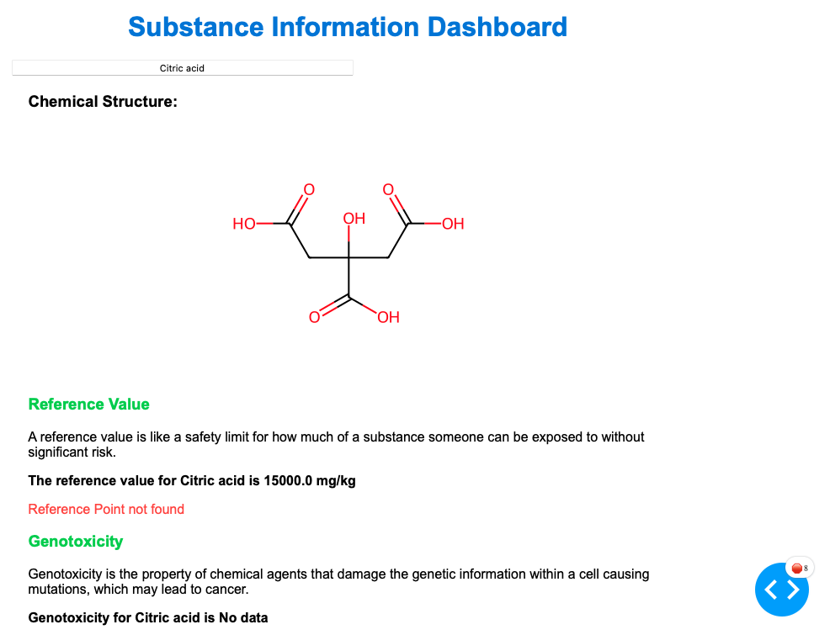

Slide 8
Future Direction – Expected Output
A user-friendly dashboard which provides consumers with easy-to-read hazard information of the chemical ingredients in products.
Taking consumers' picture of the "ingredient table”
Generalize chemicals’ names

